Slide 1
Introduction to Programming in Python
Working with Files

Slide 2
Files
Python Read Files
Python Write/Create Files
Python Delete Files

Slide 3
What’s a File?
A file is a container in computer storage devices used for storing data.
Types of Files
Binary file
Text file
The file may be in the text or binary format, and each line of a file is ended with the special character.

Slide 4
Binary Files
Document Files: pdf, doc, xls, ….
Image/ Video/ Audio files: png, jpg, mp4, 3gp, mp3, wav, mka, ….
Database files: mdb, sqlite, accde, ….
Archive files: zip, rar, iso, 7z, ….
Executable files: exe, dll, class

Slide 5
Text Files
Web standards: html, xml, css, json, etc.
Source code: c, java, py, app, js, etc.
Documents: txt, tex, rtf, etc.
Tabular data: csv, tsv, etc.
Configuration: ini, cfg, reg, etc.
Notes:
fsafe

Slide 6
Order of File Operations
Open a file
Read or write (perform operation)
Close the file

Slide 7
Opening Files in Python
Syntax: file_object = open("file_name", "mode")

Slide 8
Opening Files
We use the open() method to open files. file1 = open("test.txt")
By default, the files are open in read mode (cannot be modified). file1 = open("test.txt", "r") file1 = open("D:/folder/f1.txt", "r")
Note: the "r" argument means file is opened for reading.

Slide 9
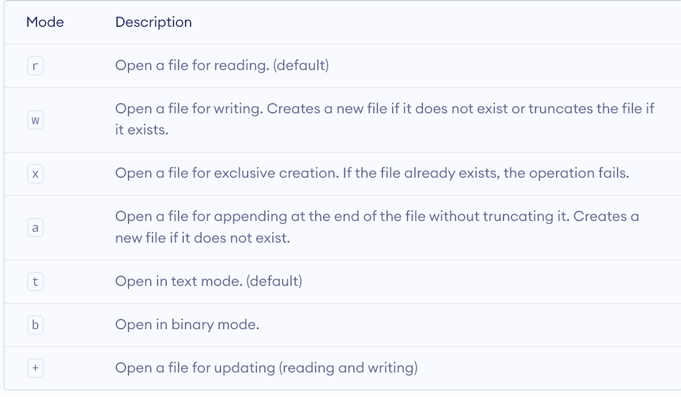
Modes of Opening Files
.

Slide 10
Read File contents
The open() function returns a file object, which has a read() method for reading the content of the file.
After we open a file, we use the read() method to read its contents. file1 = open("test.txt", "r")
print(file1.read())
// or using temp variable
file1 = open("test.txt", "r")
read_content = file1.read()
print(read_content)

Slide 11
Read Parts of the File
file1 = open("test.txt", "r")
print(file1.read(5)) // reads 5 chars of file1
You can return one line by using the readline() method: file1 = open("test.txt", "r")
print(file1.readline())
print(file1.readline())

Slide 12
Looping thru files
file1 = open("test.txt", "r")
for x in file1:
print(x)

Slide 13
Close Files
It is a good practice to always close the file when you are done with it. Closing a file will free up the resources that were tied with the file.
It is done using the close() method in Python. file1 = open("test.txt", "r")
print(file1.readline())
file1.close()
file1 = open("test.txt", "r")
print(file1.readlines())
file1.close()

Slide 14
Exception Handling in Files
If an exception occurs when we are performing some operation with the file, the code exits without closing the file.
A safer way is to use a try...finally block. try:
file1 = open("test.txt", "r")
print(file1.read(5))
finally:
file1.close()
Here, we have closed the file in the finally block as finally always executes, and the file will be closed even if an exception occurs.

Slide 15
Use of with...open Syntax
In Python, use the with...open syntax to automatically close the file.
with open("test.txt", "r") as file1:
print(file1.read(5))

Slide 16
Example: Counting words
Counting the number of words in a file. Use the split() method on strings
with open("test.txt", "r") as file1:
content = file1.read()
words = content.split()
print(“There are {0} words in the file.”.format(len(words)))

Slide 17
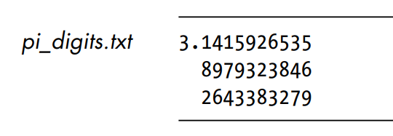
Example: pi_digits.txt
Suppose there is a file that contains pi to 30 decimal places with 10 decimal places per line:

Slide 18
Making a list of lines from a file
with open("pi_digits.txt", "r") as file_obj:
lines = file_obj.readlines()
for line in lines:
print(line.strip()) // try lstrip(), or strip()

Slide 19
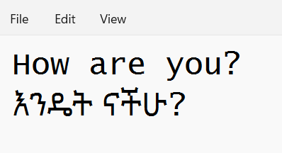
Working with non-ASCII characters
If you’re dealing with other languages such as Amharic, Chinese, and Korean, the text file is not a simple ASCII text file. And it’s likely a UTF-8 file that uses more than just the standard ASCII text characters.
To open a UTF-8 text file, pass the encoding='utf-8' to the open() function to instruct it to expect UTF-8 characters from the file.
Suppose we have the following file named myfile.txt

Slide 20
Encoding non-ASCII characters
with open("myfile.txt", encoding = "utf8") as file_obj:
for line in file_obj:
print(line)

Slide 21
Python File Write
Things to remember while writing to a file.
If we try to open a file that doesn't exist, a new file is created.
If a file already exists, its content is erased, and new content is added to the file.
In order to write into a file in Python, we need to open it in write mode by passing "w" inside open() as a second argument.
with open("test2.txt", "w") as file2_obj: file2_obj.write(‘Programming is fun.\n’) file2_obj.write(‘We\’re crafting the crafters.’)

Slide 22
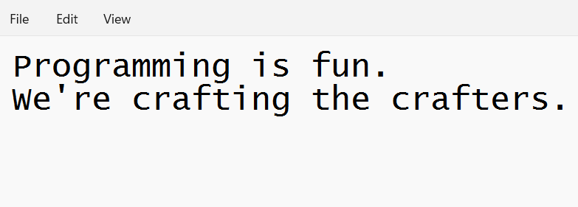
OUTPUT:

Slide 23
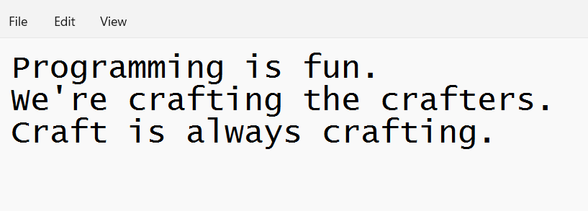
Append mode
To write to an existing file, add a parameter to the open() function:
"a" - Append - will append to the end of the file.
"w" - Write - will overwrite any existing content.
with open("test2.txt", "a") as file2_obj: file2_obj.write(‘\nCraft is always crafting.’)

Slide 24
Create a New File: parameters
"x" - Create - will create a file, returns an error if the file exist
"a" - Append - will create a file if the specified file does not exist
"w" - Write - will create a file if the specified file does not exist
#Create a file called “myfile.txt”
file1 = open("myfile.txt", "x") #Create a new file if it doesn’t exist
file1 = open("myfile.txt", "w")

Slide 25
Write methods
The open() function returns a file object that has two useful methods for writing text to the file: write() and writelines().
The write() method writes a string to a text file.
The writelines() method write a list of strings to a file at once.
The writelines() method accepts an iterable object, not just a list, so you can pass a tuple of strings, a set of strings, etc., to the writelines() method.

Slide 26
Create a file and write to it
try:
with open("docs/readme.txt", "w") as f:
f.write('Hello World’)
except FileNotFoundError:
print('The docs directory does not exist')

Slide 27
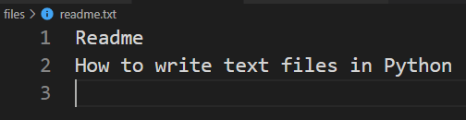
Writing text files example
lines = ['Readme', 'How to write text files in Python’]
with open("readme.txt", "w") as f:
for line in lines:
f.write(line)
f.write('\n')

Slide 28
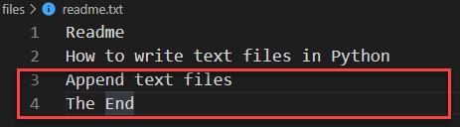
Appending more lines
more_lines = ['', 'Append text files', 'The end’]
with open("readme.txt", "a") as f: f.write('\n'.join(more_lines))

Slide 29
Python Delete Files/Folders
To delete a file, import the OS module, and run its os.remove() function:
import os
os.remove("readme.txt")
To delete an entire folder, use the os.rmdir() method:
import os
os.rmdir("folder_name")
Note: You can only remove empty folders.

Slide 30
In order to remove a non-empty directory, we can use the rmtree() method inside the shutil module.
import shutil
shutil.rmtree("folder_name")

Slide 31
Reading and Writing CSV Files in Python
A CSV file (Comma Separated Values file) is a type of plain text file that uses specific structuring to arrange tabular data. Because it’s a plain text file, it can contain only actual text data—in other words, printable ASCII or Unicode characters. Structure: column 1 name, column 2 name, column 3 name
first row data 1, first row data 2,first row data 3 second row data 1, second row data 2, second row data 3...

Slide 32
Reading CSV Files With csv
Example:
Here’s the emp_birthday.txt file: name,department,birthday month Meron Seifu,Accounting,November Ermias Amelga,IT,March
import csv
with open("emp_birthday.txt", "r") as file_obj: csvfilereader = csv.reader(file_obj)
for row in csvfilereader:
print(row)

Slide 33
Writing CSV Files With csv
import csv
with open("empfile.csv", "w") as file_obj:
emp_writer = csv.writer( file_obj, delimiter=',’,
quotechar='“’,
quoting= csv.QUOTE_MINIMAL)
line_count = 0
emp_writer.writerow(['John Smith', 'English', 'Nov'])
emp_writer.writerow(['Alex Olompia', 'Amharic', 'Sept'])

Slide 34
https://www.w3schools.com/python/python_file_handling.asp
https://www.programiz.com/python-programming/file-operation
https://pynative.com/python/file-handling/

